Slide 1
TITLE HERE
NAME HERE

Slide 2
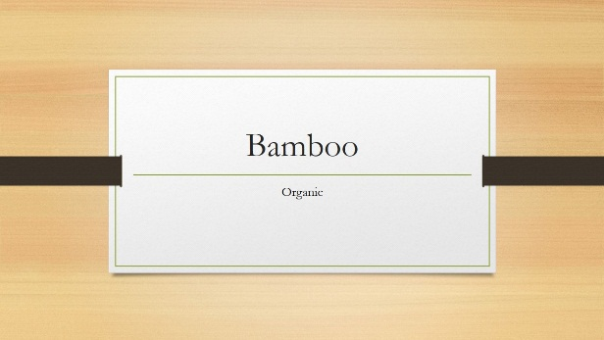
Right from the start, you’ll have access to beautiful, widescreen themes that you can easily change to match your style. Every theme comes with a variety of color variants that you can mix and match.
New features like Merge Shapes and a color-matching Eyedropper open up new possibilities for your designs.

Slide 3
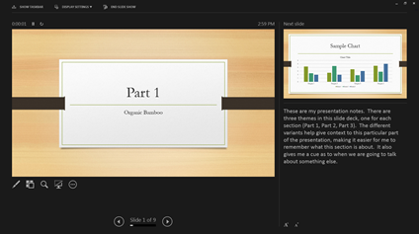
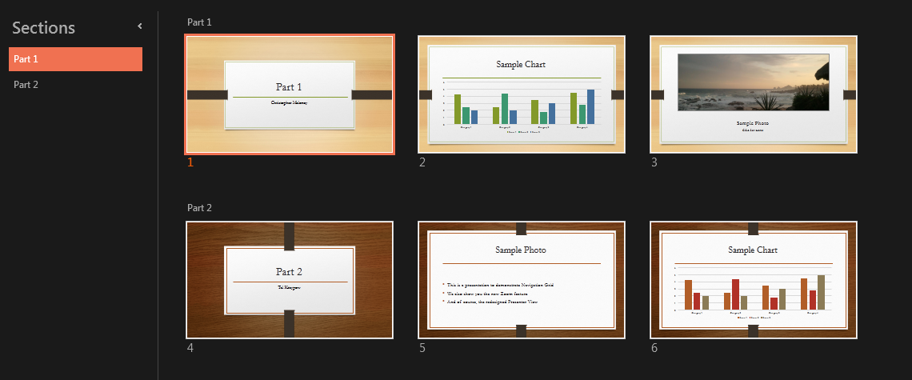
Right from the start, you’ll have access to beautiful, widescreen themes that you can easily change to match your style. Every theme comes with a variety of color variants that you can mix and match.
New features like Merge Shapes and a color-matching Eyedropper open up new possibilities for your designs.

Slide 4
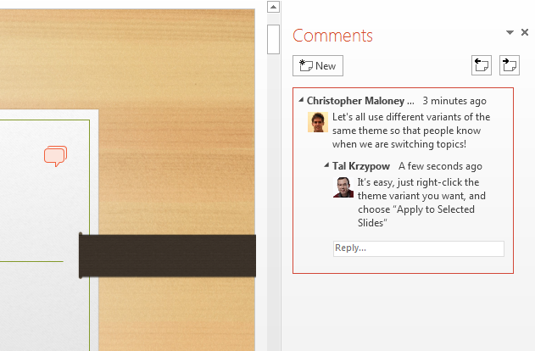
Work Together
Right from the start, you’ll have access to beautiful, widescreen themes that you can easily change to match your style. Every theme comes with a variety of color variants that you can mix and match.
New features like Merge Shapes and a color-matching Eyedropper open up new possibilities for your designs.

Slide 5
Intuitively design beautiful presentations, easily share and work together with others and give a professional performance with advanced presenting tools.
Find out more at the PowerPoint Getting Started Center
(Click the arrow when in Slide Show mode)
Notes:
In Slide Show mode, click the arrow to enter the PowerPoint Getting Started Center.

